Slide 1
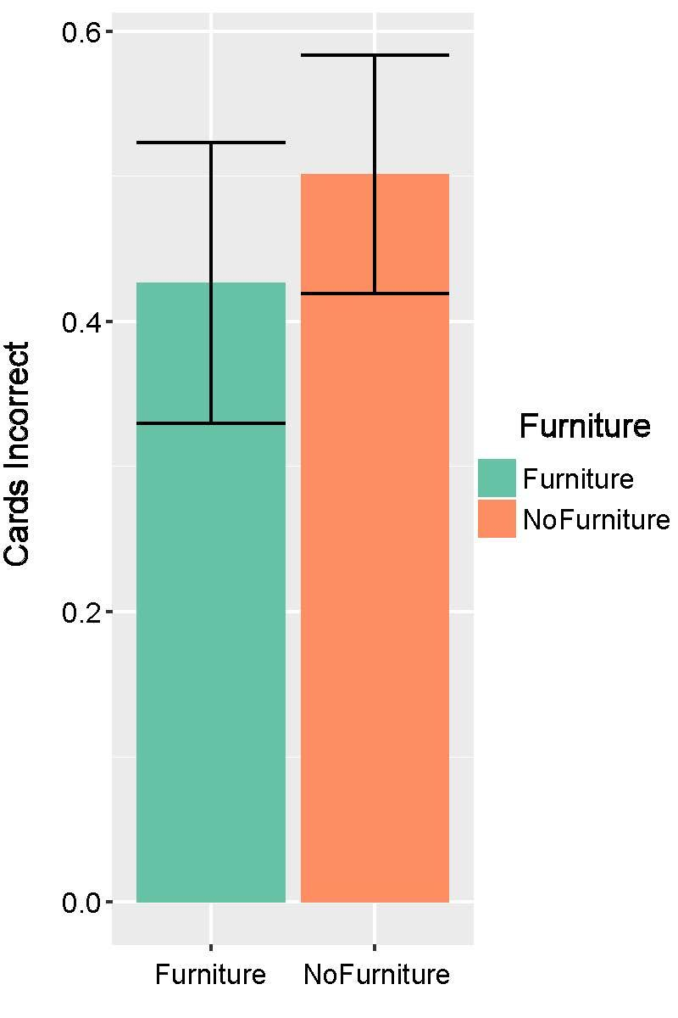
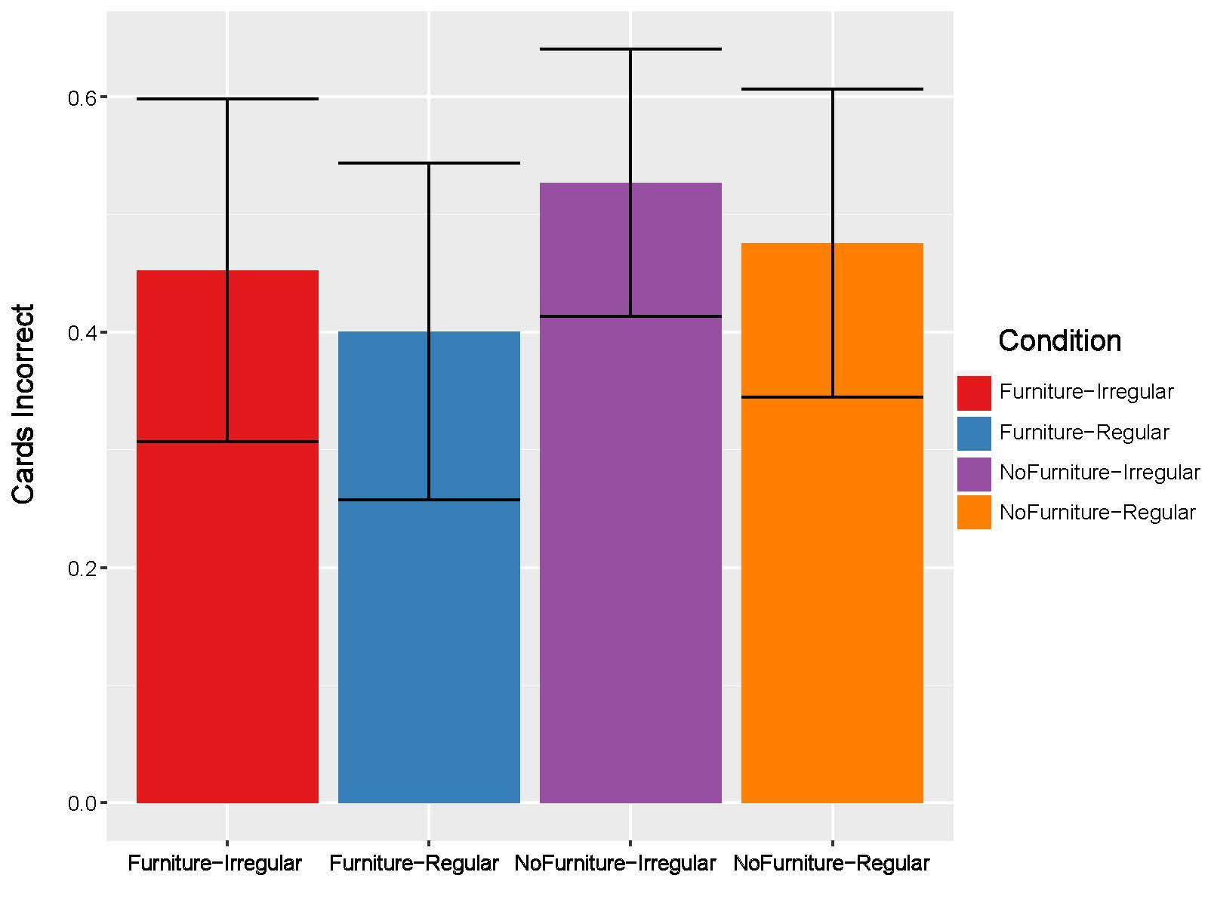
*

Slide 2
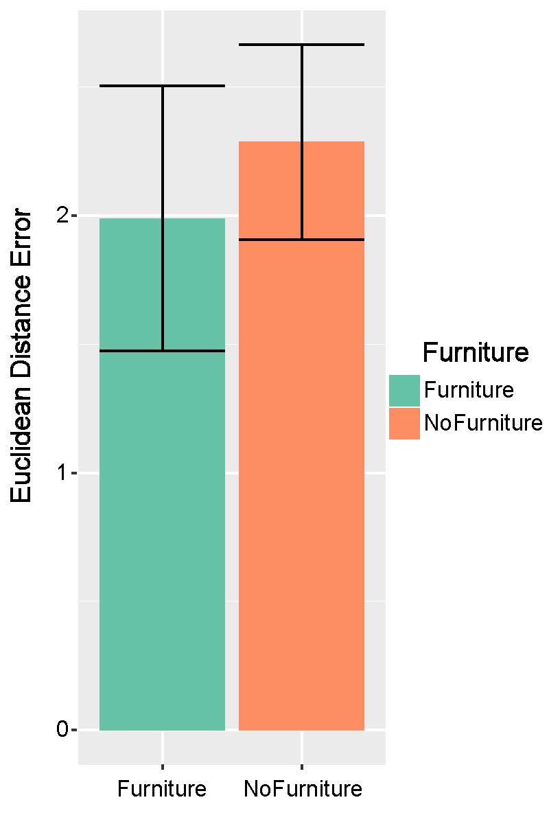
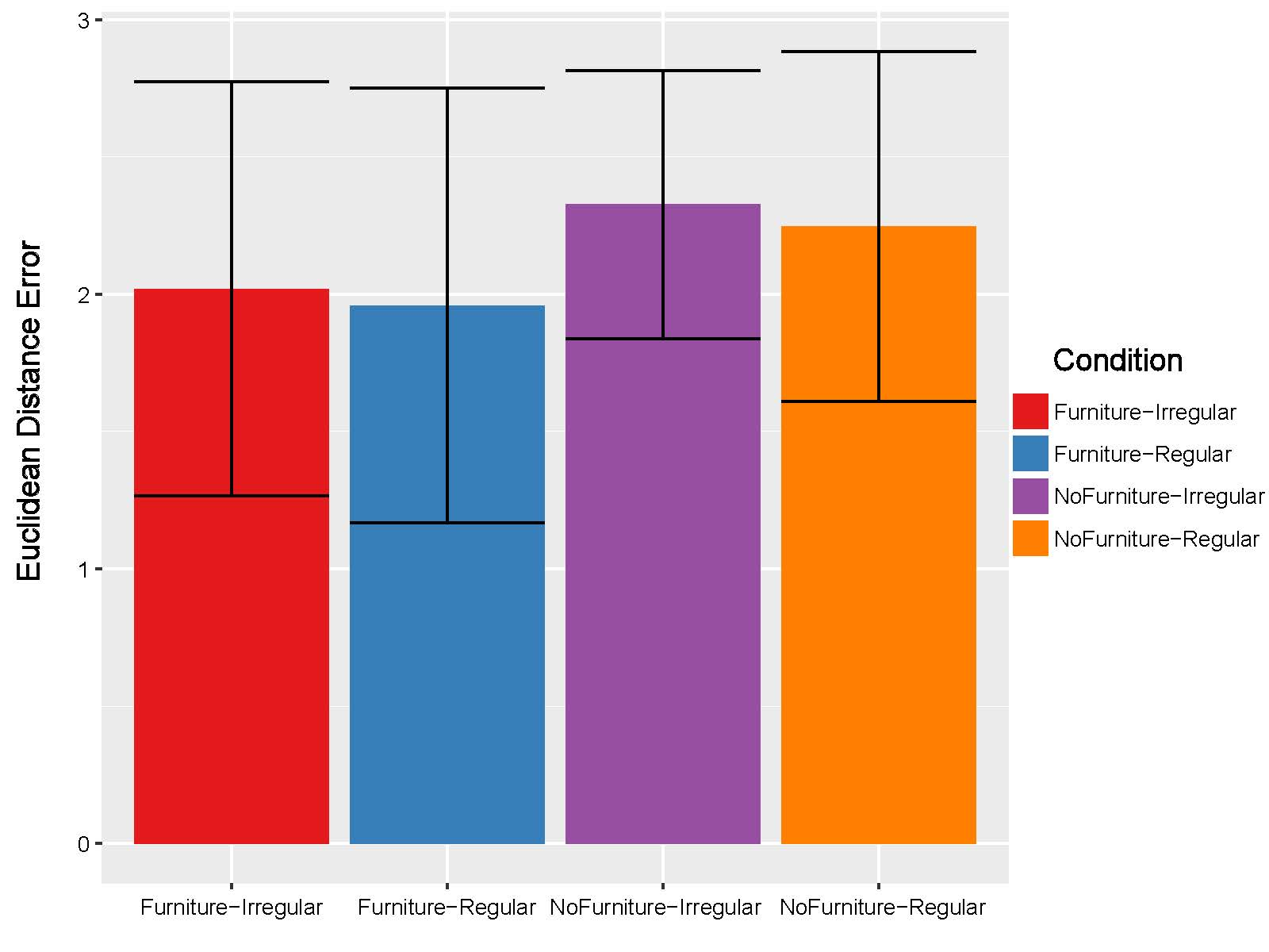

Slide 3
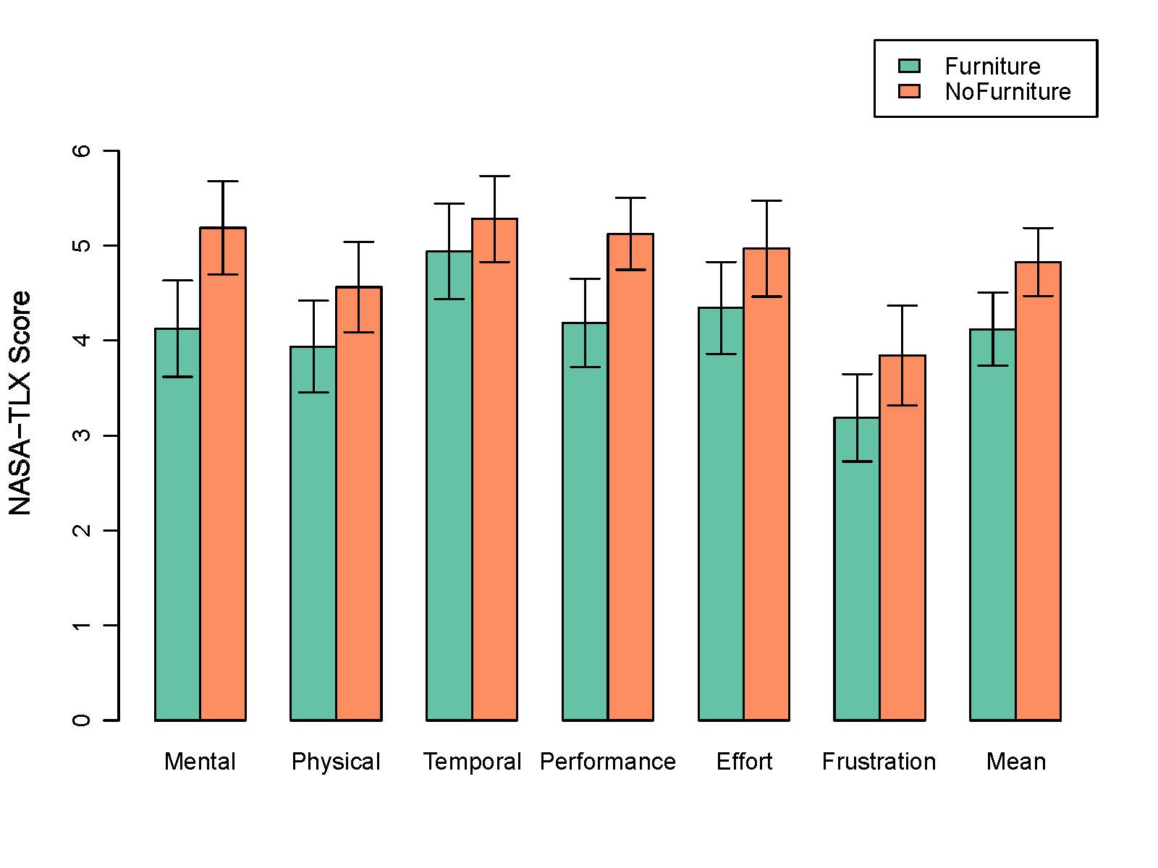
***
*
**
**
*
***

Slide 4
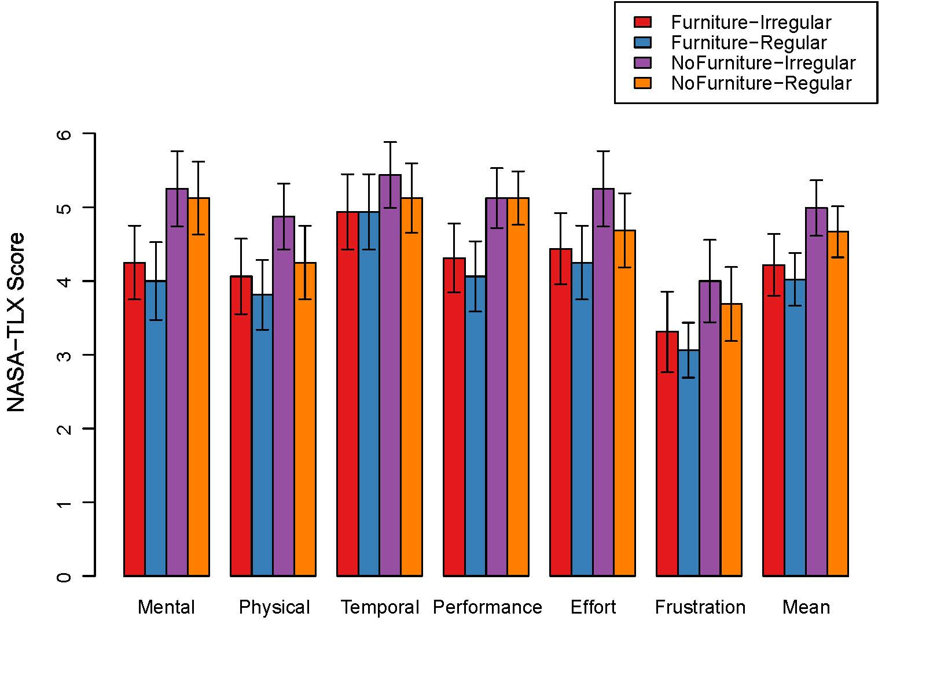
*
*
*
*

Slide 5
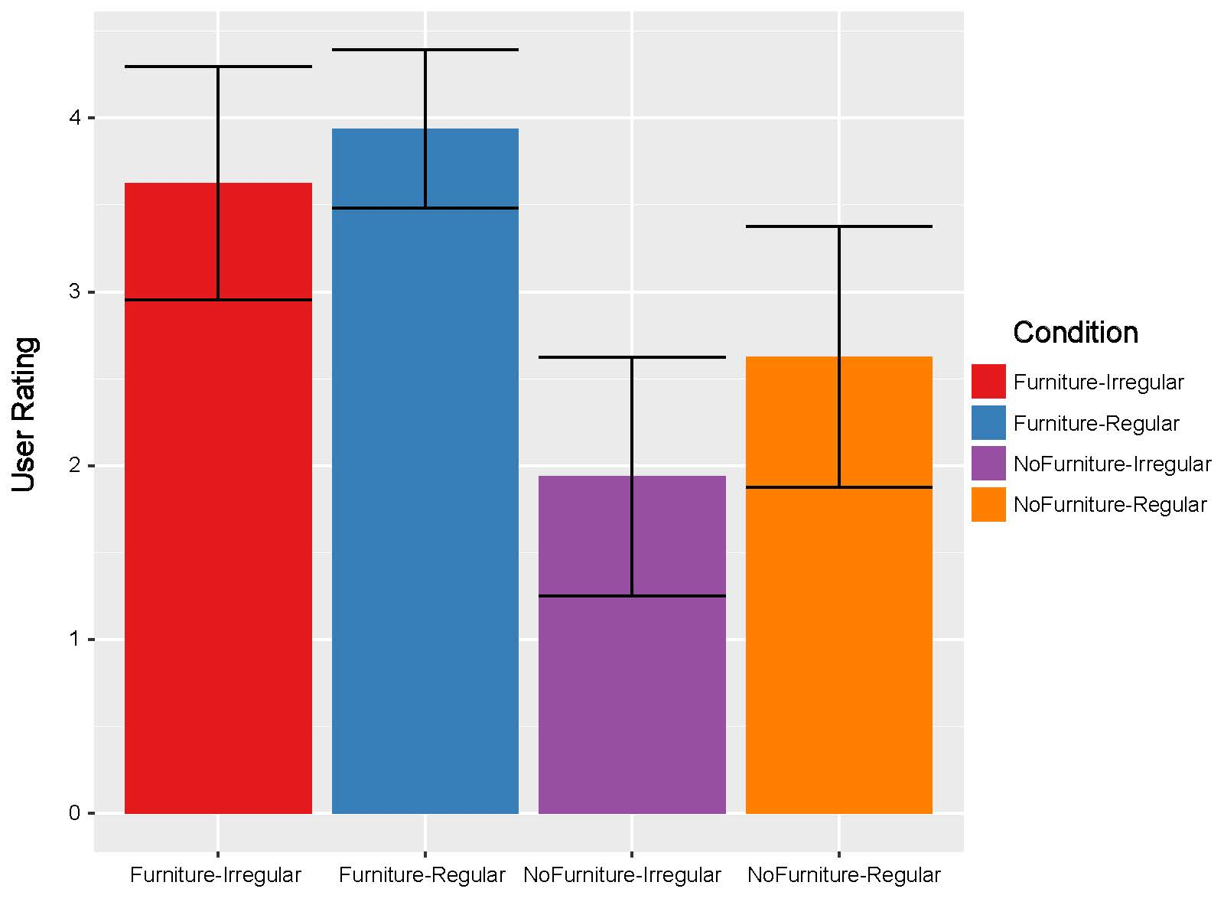
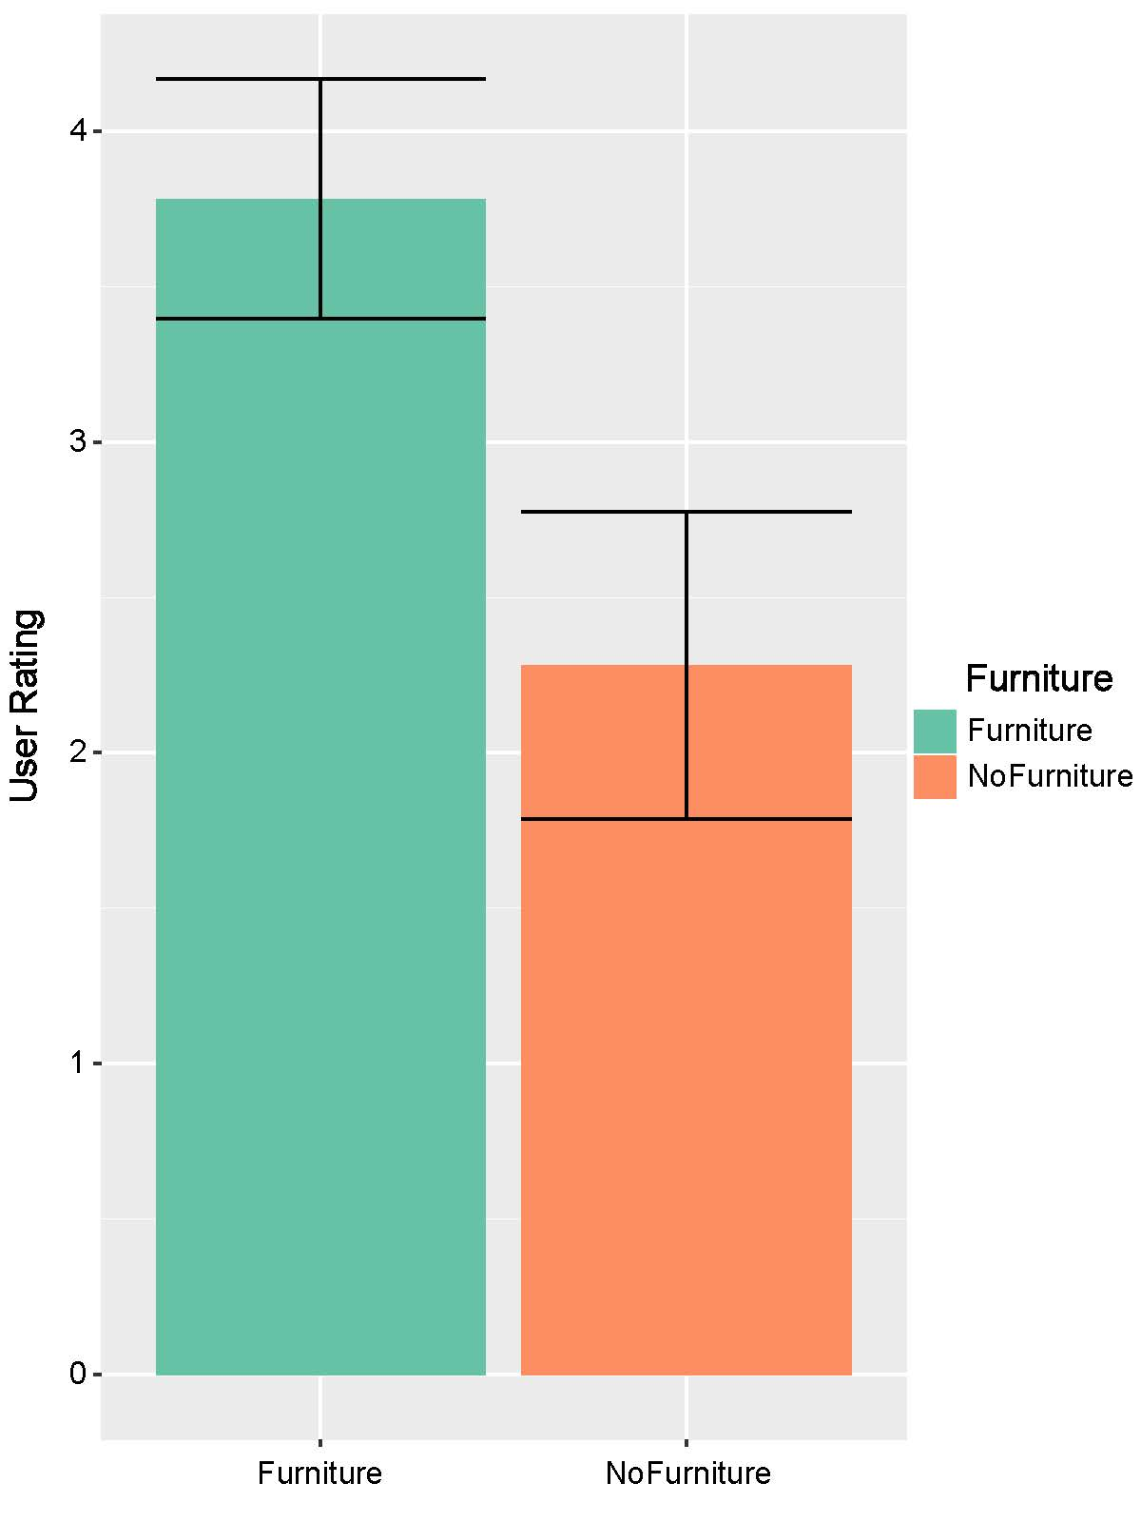
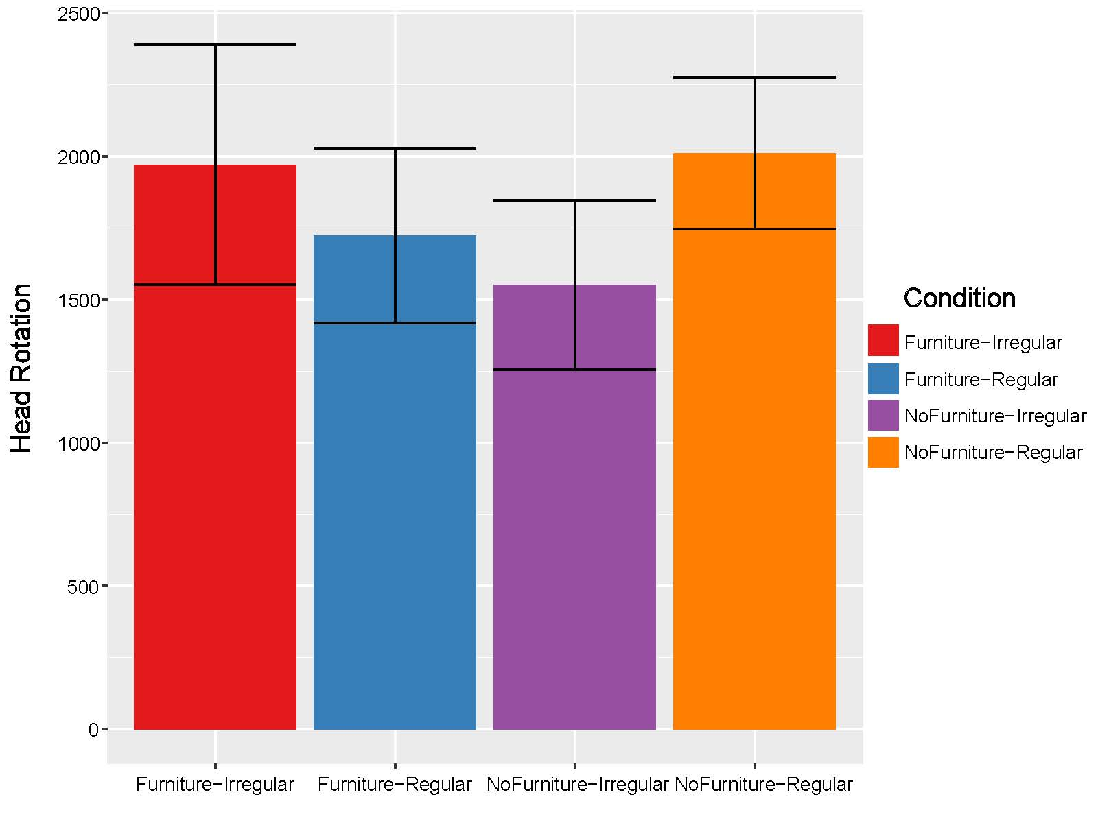
*
***
*
*
a
Furniture
NoFurniture
b
Furniture-
Irregular
Furniture-
Regular
NoFurniture-
Irregular
NoFurniture-
Regular
c
Furniture-
Irregular
Furniture-
Regular
NoFurniture-
Irregular
NoFurniture-
Regular

Slide 6
*
Condition
Furniture-Irregular
Furniture-Regular
NoFurniture-Irregular
NoFurniture-Regular
a
Furniture
NoFurniture
b
Furniture
NoFurniture
c
Furniture-
Irregular
Furniture-
Regular
NoFurniture-
Irregular
NoFurniture-
Regular
d
Furniture-
Irregular
Furniture-
Regular
NoFurniture-
Irregular
NoFurniture-
Regular

Slide 7
*
a
Furniture
NoFurniture
b
Furniture
NoFurniture
c
Furniture-
Irregular
Furniture-
Regular
NoFurniture-
Irregular
NoFurniture-
Regular
d
Furniture-
Irregular
Furniture-
Regular
NoFurniture-
Irregular
NoFurniture-
Regular

Slide 8
*
***
*
*
a
Furniture
NoFurniture
b
Furniture-
Irregular
Furniture-
Regular
NoFurniture-
Irregular
NoFurniture-
Regular
c
Furniture-
Irregular
Furniture-
Regular
NoFurniture-
Irregular
NoFurniture-
Regular

Slide 9
***
*
**
**
*
***
*
*
*
*

